Slide 1
Summary of Steering Committee Meeting
22 March 2007

Slide 2

New Institutions
Konkuk University – 30th member

Slide 3
Working Groups
New Working Group
  Proposal for Geoscience Working Group Accepted
  Ryosuke Nakamura (AIST); Guey-Shin Chang (NARL); Ashraf Memon (UCSD)
Working groups are evolving
  This meeting shows this
Charge to all Working Groups, from the steering committee
  Two demos at each meeting

Slide 4
Briefing and Some Discussion Topics
Study of PRAGMA Group Dynamics
Future Success
  Knowing the computing environment
  Sharing expertise, approaches, and software
  Keeping open conduit of technology development
  Migrating application successes to larger machines
  Ultimately, its about users using grid for new science and new ways of doing science
Costs of Hosting Meetings
Role of Industry

Slide 5
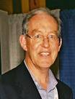
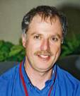


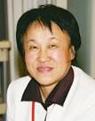
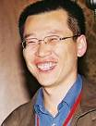
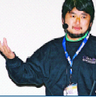

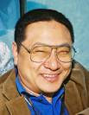

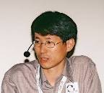
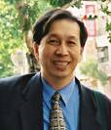
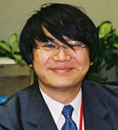
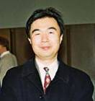
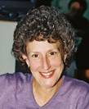

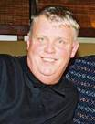
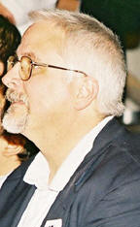
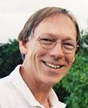
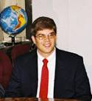
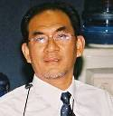

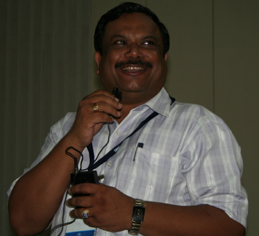
The PRAGMA Steering Committee
http://www.pragma-grid.net/people/committee/
Notes:
20 Oct 05
Need to add
- Santosh
- Susumu
- Chalermpol Charnsripinyo (NECTEC)
- Arun Agarwal

Slide 6
Steering Committee Composition
PRAGMA has grown from 14 to 30 institutions.
Key principles for composition of Steering Committee
  Contribution of individual
  Continued success of PRAGMA
  Representative of all members
  Regional Diversity
  Limited Size
  Retain PRAGMA “memory”
  Direct involvement in working groups
Hosting Meeting: Strategic Activity

Slide 7
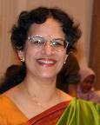
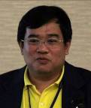
Rotation
Agreed to rotational scheme
2 years for each member – renewable
Retiring members
New Members
Maxine
Brown
StarLight
Guna
Rajagopal
BII A*Star
Radha
Nandkumar
NCSA
Putchong
Uthayopas
TNGC

Slide 8
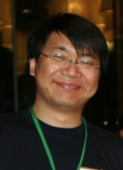
Deputy Chair
Fang-Pang
Lin
NCHC
Piyawut
Srichaikul
NECTEC

Slide 9


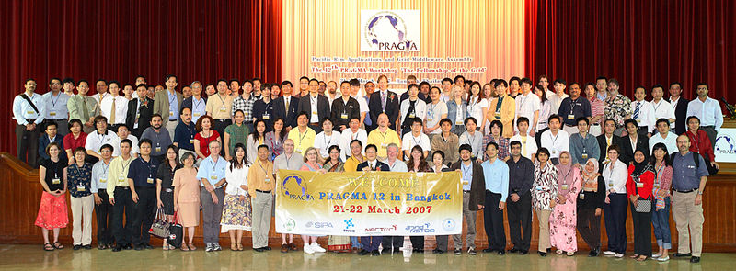
Thank You

